Slide 1

BRAIN-EYE CONNECTION
PRESENTED BY
IBRAHEEM AL-ABDULELAH
RASHEED ALSHAHRANI
TIANCHENG XU
YIFAN LI
Mentor: Gabitov, Ilder

Slide 2
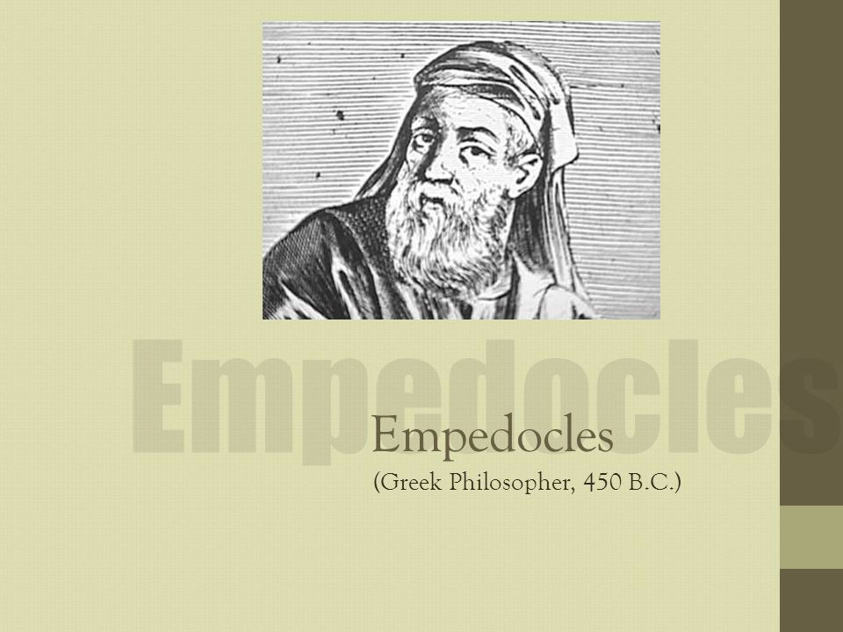
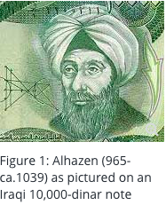
History of Eye-Brain connection:
The first man who introduced the eye-brain connection was the Greek philosopher Empedocles around 450 BCE.
Then Alhazen did present around 1000 CE he developed a new and more rigorous approach to the optical science field.
One of Alhazen's most significant contributions was a seven-volume work on optics titled Kitab al-Manazir (later translated to Latin as Opticae Thesaurus Alhazeni – Alhazen's Book of Optics).
Later, multiple of researcher and scientist searched in this field and discovered more things about the human’s eye.

Slide 3
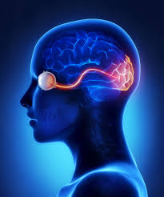
What is Eye-Brain connection?
It is the connection that allows our eye to convert what we see into recognizable colored figures

Slide 4
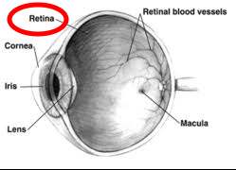
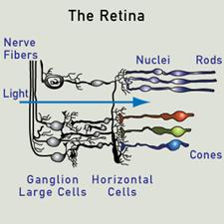
How Does it Work?
Light and color are converted to electrical signals.
The signals reach the Optic Nerve.
Then these signals are transformed to different parts in the brain allowing it to build and reverse what the eye see.

Slide 5
2- known results and challenges
In everyone’s Body, we have 10000000000 which is 10¹⁰ number of Neurons. For each Neuron, it has 10⁴ Synapses.
So, the total Synapses in our body is the number of Neurons times Synapses per Neuron, which is 10¹⁰ times 10⁴ which is 10¹⁴. This is a really big number, right？

Slide 6
Here are Larger numbers!
Since we have 10¹⁰ neurons and 10¹⁴ synapses, and each neuron will have connection to a synapse, so there is 10¹⁰ to the 10¹⁴ information microstate, expressed by Γ = N^{Ns} . Which is a super big number.
The H, information entropy, means the space that you can store in your brain(amount of information need to know), can be expressed
as H = log(Γ) = NS(Log N) = 400 terabytes = 45 Years HD Vedio.

Slide 7
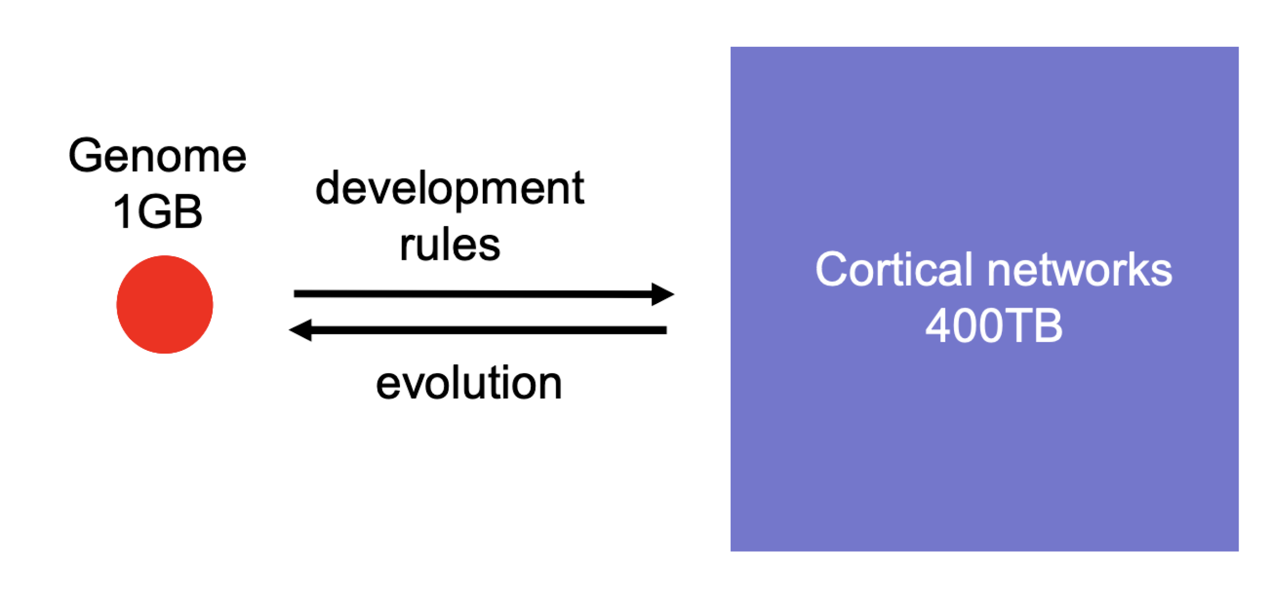
But...
Human Genome only contains 3*10⁹ bp, which is about 1 Gigabyte ‘s information. How can 1 Gb of information set up 400 TB of connections？
Obviously, each synapse can’t be specified in the genome individually,there must some rules to make the system works perfectly.

Slide 8
Chanllenges it brings
1.Obviously, figure out the rule of developing connections is one of the important thing to our project. Since the System is really complicated, we can’t demonstrate everything exactly.
2.And we also want to figure out how can genetic information be combined with experience dependent network plasticity.

Slide 9
Luckily..
For the first question, someone already get the result and answered it for us.
“Genetic information is converted into connectivity patterns by virtue of molecular tags“
-Dr.Roger Sperry, Nobel Prize in medicine 1981.

Slide 10
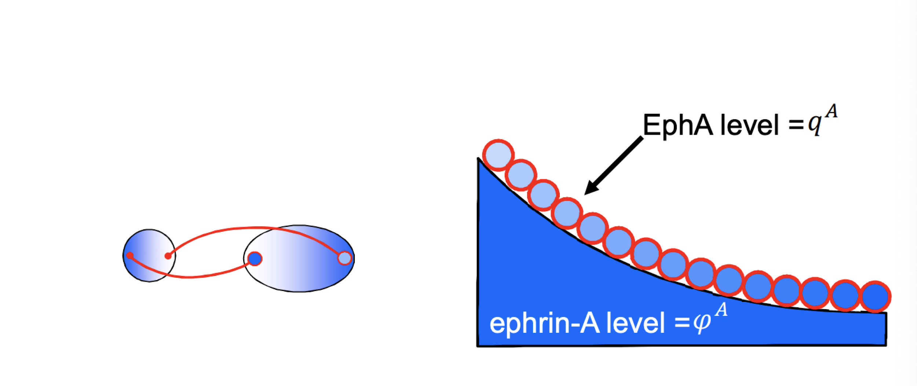
What is that?
The tag can determine the direction of synapses expandation by the concentration of proteins on cortex, every tag has it’s unique direction. So it’s can make different combinations, develop connections and produce such a big information entropy.

Slide 11
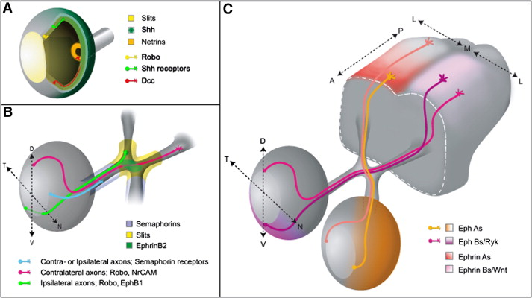
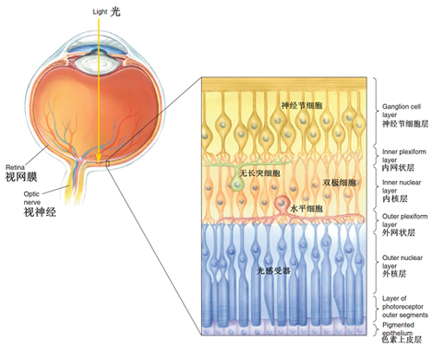
Our target and the plan
the schematic diagram of eye and brain showed below:

Slide 12
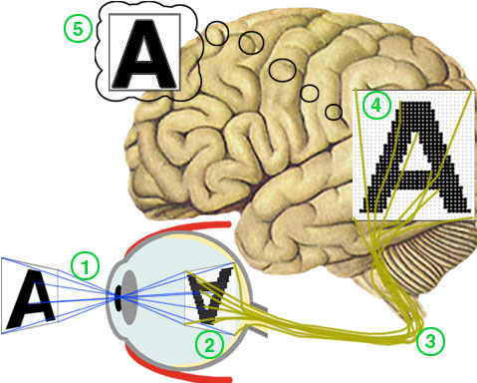
Target: Modeling the neuron network between eye and brain
The plan :
Understanding where and how retina collective optical signal
Modeling the geometric structure and arranging of neurons between eye and brain
Understand how the gene use its codes regulate the cortical neuron network and formed the vision.

Slide 13
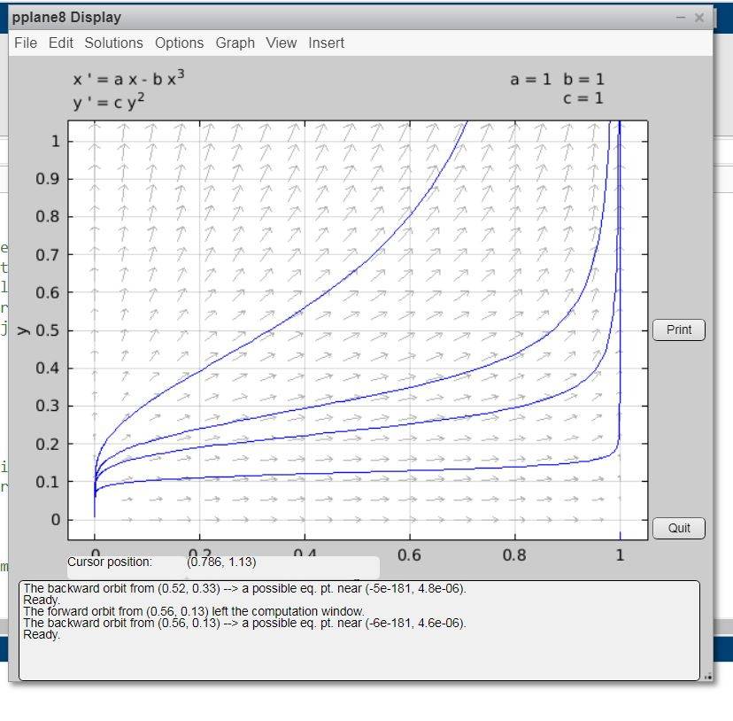
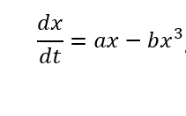

Differential Equations Approach in 2D

Slide 14
Alternative method:
Random walk with changing probability:

Slide 15
Extension to 3D: Concerns
1- Non-swerling neurites
2- No overlap in the simulation
3- The Random walk will have 3 times the complications

Slide 16
Refrences
https://www.brainfacts.org/thinking-sensing-and-behaving/vision/2019/the-eye-brain-connection-061819
https://www.umkelloggeye.org/conditions-treatments/anatomy-eye
https://www.sciencedirect.com/science/article/pii/S0012160607009098
https://www.visionlearning.com/en/library/Hidden/59/Alhazen:-Early-experiments-on-light/170
The retinal ganglion cell axon's journey: Insights into molecular mechanisms of axon guidance。https://www.sciencedirect.com/science/article/pii/S0012160607009098
从视网膜到视皮层-系统视觉知多少 http://www.sibs.cas.cn/kp/kptw/201606/t20160620_4623663.html。

